Slide 1
MUSIC DATA ANALYSIS
SQL PROJECT

Slide 2

"A brief introduction to the tables used for analysis in this dataset

Slide 3

Employee-> dataset containing information about employees in an organization. This dataset consists of several key attributes, including employee identification numbers, names, job titles, reporting hierarchy, personal details, and contact information.
customers -> dataset that contains valuable information about our customers. This dataset comprises various attributes, including customer identification numbers, names, company details, contact information, and support representative assignments.
invoice -> dataset containing valuable information about our invoices. This dataset encompasses various attributes, including invoice identification numbers, customer details, invoice dates, billing addresses, and invoice totals.
invoice lines -> dataset that contains crucial information about our invoice lines. This dataset includes attributes such as invoice line identification numbers, associated invoice identification numbers, track identification numbers, unit prices, and quantities.
tracks -> dataset containing essential information about our tracks. This dataset includes attributes such as track identification numbers, track names, associated album identification numbers, media type identification numbers, genre identification numbers, composer details, durations, file sizes, and unit prices.

Slide 4
media types -> Dataset containing important information about media types. This dataset includes attributes such as media type identification numbers and corresponding names.
genres -> dataset containing essential information about music genres. This dataset includes attributes such as genre identification numbers and corresponding genre names.
artists ->Dataset containing essential information about artists. This dataset includes attributes such as artist identification numbers and corresponding artist names.
albums ->dataset containing crucial information about albums. This dataset includes attributes such as album identification numbers, album titles, and associated artist identification numbers.
playlists -> dataset containing important information about playlists. This dataset includes attributes such as playlist identification numbers and corresponding playlist names.
Playlists_ tracks ->dataset containing important information about the tracks included in playlists. This dataset includes attributes such as playlist identification numbers and associated track identification numbers.

Slide 5
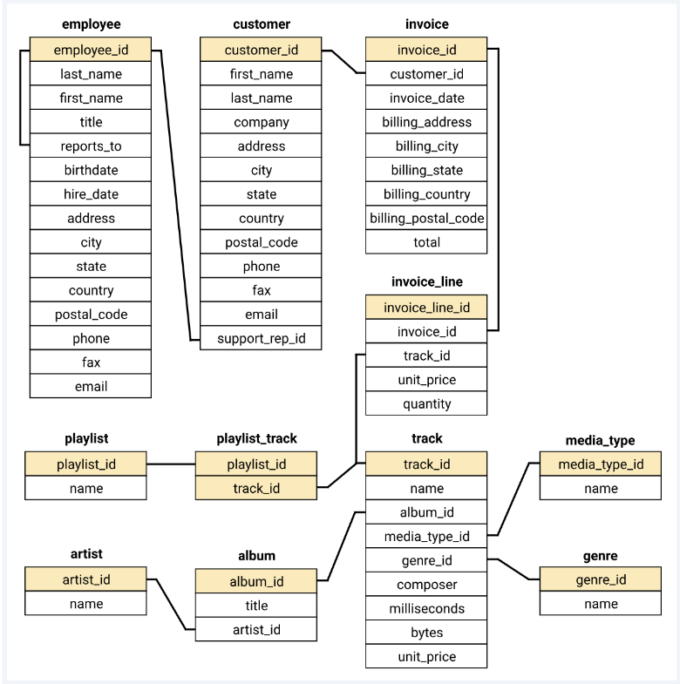
A dataset's schema is a blueprint that describes the structure of the data. It defines the columns, rows, and data types of the data. The schema helps us understand the data by providing a way to organize the data and by providing information about the context of the data.

Slide 6
PHASE FIRST

Slide 7
Who is the senior most employee baseD on job title?
select first_name,title from employee
where levels=(select max(levels) from employee);

Slide 8
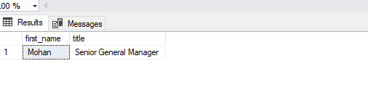
OUTPUT

Slide 9
2. Which countries have the most Invoices?
--select * from invoice;
--TOP 5 Countries have the most Invoices
select top 5 billing_country as country,count(invoice_id) as invoice_count
from invoice
group by billing_country
order by invoice_count desc;
--OR--ALL COUNTRY-- ACCORDING TO THEIR INVOICE
select billing_country,count(invoice_id) as invoice_count
from invoice
group by billing_country
order by invoice_count desc;

Slide 10
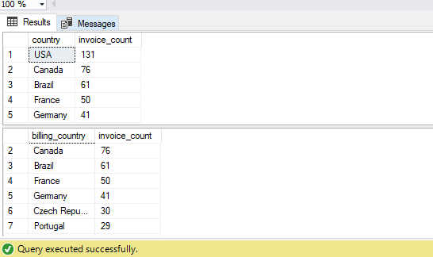
OUTPUT

Slide 11
3. What are top 3 values of total invoice?
SELECT top 3 customer_id,SUM(total) total
FROM invoice
group by customer_id
order by total desc;
---or--
SELECT TOP 3 total
FROM invoice
ORDER BY total DESC;

Slide 12
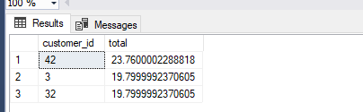
OUTPUT

Slide 13
--4. Which city has the best customers? We would like to throw a promotional Music Festival in the city we made the most money. Write a query that returns one city that has the highest sum of invoice totals. Return both the city name & sum of all invoice totals
select top 1 billing_city,sum(total) invoice_total
from invoice
group by billing_city
order by invoice_total desc;

Slide 14

OUTPUT

Slide 15
--5. Who is the best customer? The customer who has spent the most money will be declared the best customer. Write a query that returns the person who has spent the most money
SELECT TOP 1 c.customer_id, first_name, last_name, SUM(total) AS total_spending
FROM customer c
JOIN invoice i ON c.customer_id = i.customer_id
GROUP BY c.customer_id, first_name, last_name
ORDER BY total_spending DESC
-- top 5 best customer
SELECT TOP 5 c.customer_id, first_name, last_name, SUM(total) AS total_spending
FROM customer c
JOIN invoice i ON c.customer_id = i.customer_id
GROUP BY c.customer_id, first_name, last_name
ORDER BY total_spending DESC

Slide 16
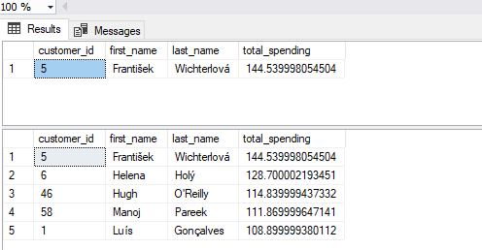
OUTPUT

Slide 17
PHASE SECOND

Slide 18
1. Write query to return the email, first name, last name, & Genre of all Rock Music listeners. Return your list ordered alphabetically by email starting with A
select distinct c.first_name,c.last_name,c.email,g.name
from customer c join invoice i on c.customer_id=i.customer_id
join invoice_line il on i.invoice_id=il.invoice_id
join track t on il.track_id=t.track_id
join genre g on g.genre_id=t.genre_id
where g.name='Rock'
order by email;

Slide 19
CONTINUE
---------------------another method-------
SELECT DISTINCT email,first_name, last_name
FROM customer
JOIN invoice ON customer.customer_id = invoice.customer_id
JOIN invoice_line ON invoice.invoice_id = invoice_line.invoice_id
WHERE track_id IN(
SELECT track_id FROM track
JOIN genre ON track.genre_id = genre.genre_id
WHERE genre.name LIKE 'Rock')
ORDER BY email;

Slide 20
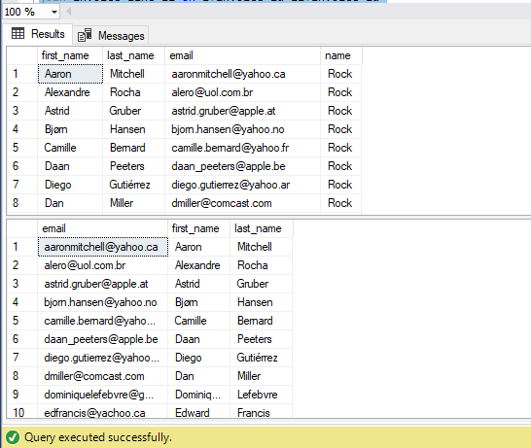
OUTPUT

Slide 21
--2. Let's invite the artists who have written the most rock music in our dataset. Write a query that returns the Artist name and total track count of the top 10 rock bands
select top 10 a.name,count(g.name) as no_track
from artist a join album ab on ab.artist_id = a.artist_id
join track t on ab.album_id=t.album_id
join genre g on t.genre_id = g.genre_id
where g.name ='Rock'
group by a.name
order by no_track desc;

Slide 22
CONTINUE
---------------------or another_method =------------------------
SELECT TOP 10 a.artist_id, a.name, COUNT(a.artist_id) AS number_of_songs
FROM track
JOIN album ab ON ab.album_id = track.album_id
JOIN artist a ON a.artist_id = ab.artist_id
JOIN genre ON genre.genre_id = track.genre_id
WHERE genre.name LIKE 'Rock'
GROUP BY a.artist_id, a.name
ORDER BY number_of_songs DESC

Slide 23
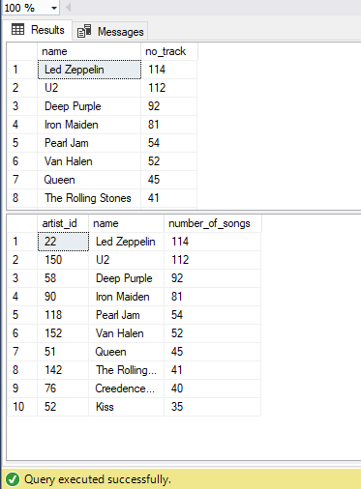
OUTPUT

Slide 24
--3. Return all the track names that have a song length longer than the average song length. Return the Name and Milliseconds for each track. Order by the song length with the longest songs listed first
select name , milliseconds , milliseconds/60000 as minutes
from track
where milliseconds/60000 > (select avg(milliseconds)/60000 from track)
order by milliseconds desc;
----------------------------or another_method ----------------------
SELECT name,milliseconds
FROM track
WHERE milliseconds > (
SELECT AVG(milliseconds) AS avg_track_length
FROM track )
ORDER BY milliseconds DESC;

Slide 25
CONTINUE
--OR--ADVANCE VERSION--
select a.name as artist_name ,t.name as track_name , t.milliseconds , t.milliseconds/60000 as minutes
from track t join album ab on t.album_id =ab.album_id
join artist a on ab.artist_id = a.artist_id
where t.milliseconds/60000 > (select avg(milliseconds)/60000 from track)
order by t.milliseconds desc;

Slide 26
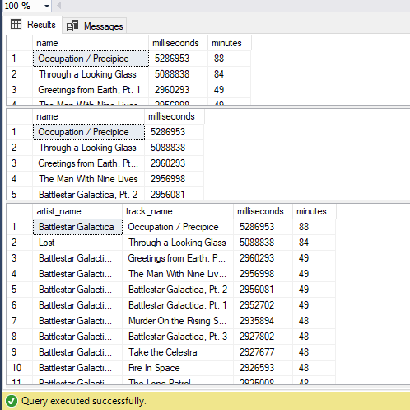
OUTPUT

Slide 27
PHASE THIRD

Slide 28
--1. Find how much amount spent by each customer on artists? Write a query to return customer name, artist name and total spent
-------****----*-BASIC_VERSION---*-----****----------
select c.customer_id,a.name,sum(i.total) total_spent
from customer c join invoice i on c.customer_id = i.customer_id
join invoice_line il on i.invoice_id=il.invoice_id
join track t on il.track_id = t.track_id
join album ab on t.album_id = ab.album_id
join artist a on ab.artist_id=a.artist_id
group by c.customer_id,a.name
order by c.customer_id desc;

Slide 29
CONTINUE
--------------------*****--AND THE FINAL FORM OF THIS QUESTION IS ---*****----
SELECT c.customer_id,c.first_name,c.last_name,a.name,
SUM(i.total) AS total_spent,
SUM(SUM(i.total)) OVER (PARTITION BY c.customer_id) AS total_spent_by_customer
FROM
customer c
JOIN invoice i ON c.customer_id = i.customer_id
JOIN invoice_line il ON i.invoice_id = il.invoice_id
JOIN track t ON il.track_id = t.track_id
JOIN album ab ON t.album_id = ab.album_id
JOIN artist a ON ab.artist_id = a.artist_id
GROUP BY
c.customer_id,
c.first_name,
c.last_name,
a.name
ORDER BY
c.customer_id DESC;

Slide 30
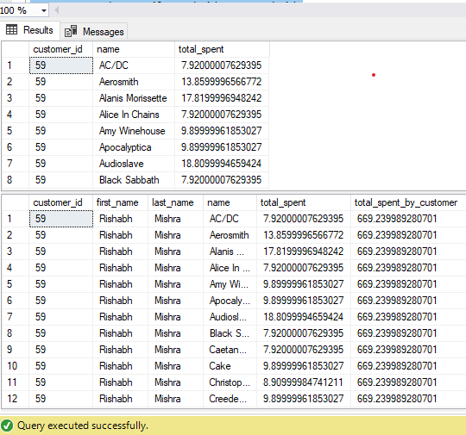
OUTPUT

Slide 31
---2. We want to find out the most popular music Genre for each country. We determine the most popular genre as the genre with the highest amount of purchases. Write a query that returns each country along with the top Genre. For countries where the maximum number of purchases is shared return all Genres
WITH k AS (
SELECT i.billing_country, g.name, SUM(i.total) AS total_spent
FROM invoice i
JOIN invoice_line il ON i.invoice_id = il.invoice_id
JOIN track t ON il.track_id = t.track_id
JOIN genre g ON t.genre_id = g.genre_id
GROUP BY i.billing_country, g.name),
ranked_k AS (
SELECT *,ROW_NUMBER() OVER (PARTITION BY billing_country ORDER BY total_spent DESC) AS genre_rank
FROM k)
SELECT billing_country, name, total_spent
FROM ranked_k
WHERE genre_rank = 1
ORDER BY billing_country ASC;

Slide 32
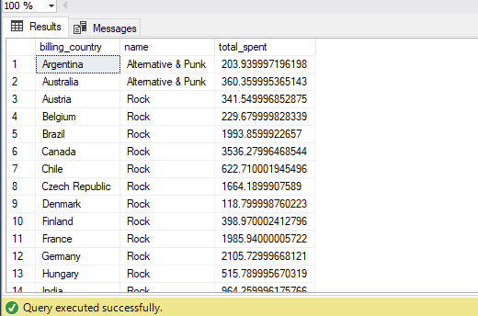
OUTPUT

Slide 33
--3. Write a query that determines the customer that has spent the most on music for each country. Write a query that returns the country along with the top customer and how much they spent. For countries where the top amount spent is shared, provide all customers who spent this amount
----------------------FIRST_PART------------------
WITH a AS (
SELECT c.customer_id,c.first_name,c.last_name,i.billing_country,SUM(i.total) AS total_invoice
FROM customer c JOIN invoice i ON c.customer_id = i.customer_id
GROUP BY c.customer_id, c.first_name, c.last_name, i.billing_country),
b AS (
SELECT *, DENSE_RANK() OVER (PARTITION BY billing_country ORDER BY total_invoice DESC) AS rnk
FROM a)
SELECT * FROM b
where rnk=1

Slide 34
CONTINUE
----------------------------------SECOND_PART----------------------------
-- Write a query that returns the country along with the top customer and how much they spent
WITH a AS (
SELECT c.customer_id,c.first_name,c.last_name,i.billing_country,SUM(i.total) AS total_spent_on_music
FROM customer c JOIN invoice i ON c.customer_id = i.customer_id
GROUP BY c.customer_id, c.first_name, c.last_name, i.billing_country),
b AS (
SELECT a.customer_id,a.first_name,a.last_name,a.billing_country,a.total_spent_on_music,
RANK() OVER (PARTITION BY a.billing_country ORDER BY a.total_spent_on_music DESC) AS rnk,
MAX(a.total_spent_on_music) OVER (PARTITION BY a.billing_country) AS max_spent_on_music
FROM a)
SELECT b.first_name,b.last_name,b.billing_country,b.total_spent_on_music
FROM b
WHERE b.total_spent_on_music = b.max_spent_on_music
ORDER BY
b.billing_country,
b.total_spent_on_music DESC

Slide 35
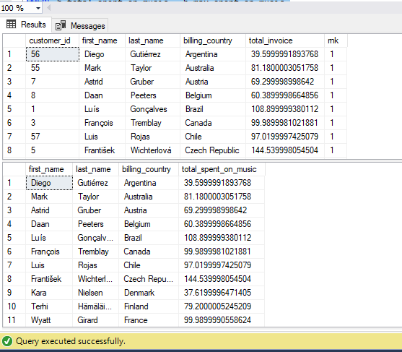
OUTPUT

Slide 36


